Slide 1

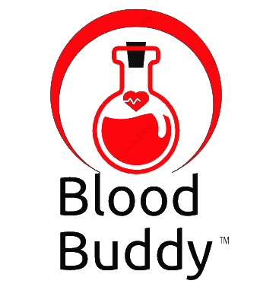
BLOOD BUDDY
Co-founders:
Sai Maneesh Reddy Kadire
Venkata Suchitra Varanasi
Sai Priya Anchuri
Rohith Babu Ginjupalli
Yaswanth Reddy Mallu

Slide 2

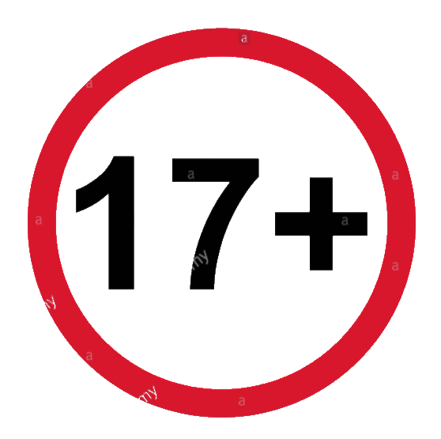
TARGET MARKET & VALUE PROPOSITIONS
Target Market:
Our app does not have any restriction on receivers or patients irrespective of age, location, income, lifestyle, gender and race.
But for donors we are targeted only greater than age 17, because legal age to donate blood is 17.
Value Propositions:
We promise that no life will be loss due to lack of blood. And we are maintaining punctuality as our key motto.
We promise that we will contact the blood banks and trust near by, If no donor is near by the receiver location.
We promise 2 free doctor consultations for donor if donor reaches to highest rank.
Only for Donors

Slide 3
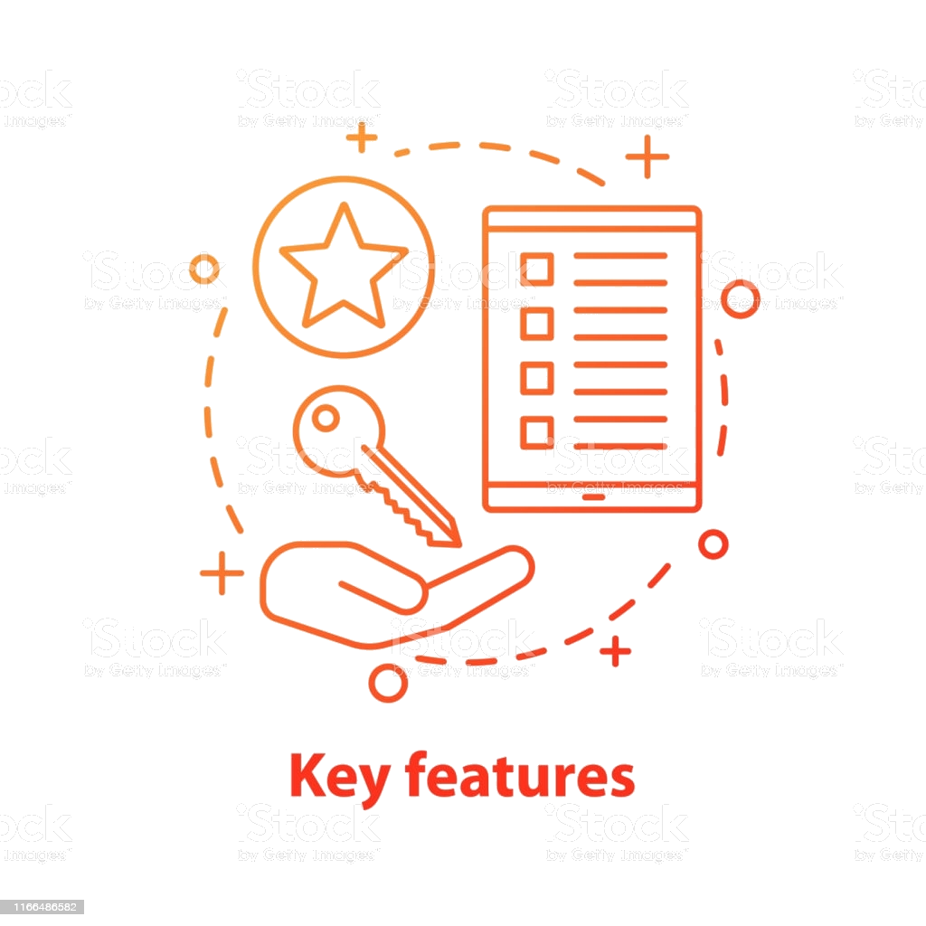
WINNING FEATURES & JUSTIFICATION
Key Features:
Filtering users based on Location.
Send Notifications to only donors who has Similar to receiver BG.
When No matching donor found, our applications will send notifications to all universal donor (O+ve ).
If no response from donors and reaching to target time, app send alerts to near by BLOOD BANK.
Justification:
No LOSS OF LIFE due to
Improper communications which leads to late response.
Connecting donors on a single platform whenever there is an emergency.
Maintained different time phases, each phase trigger based on previous results.

Slide 4
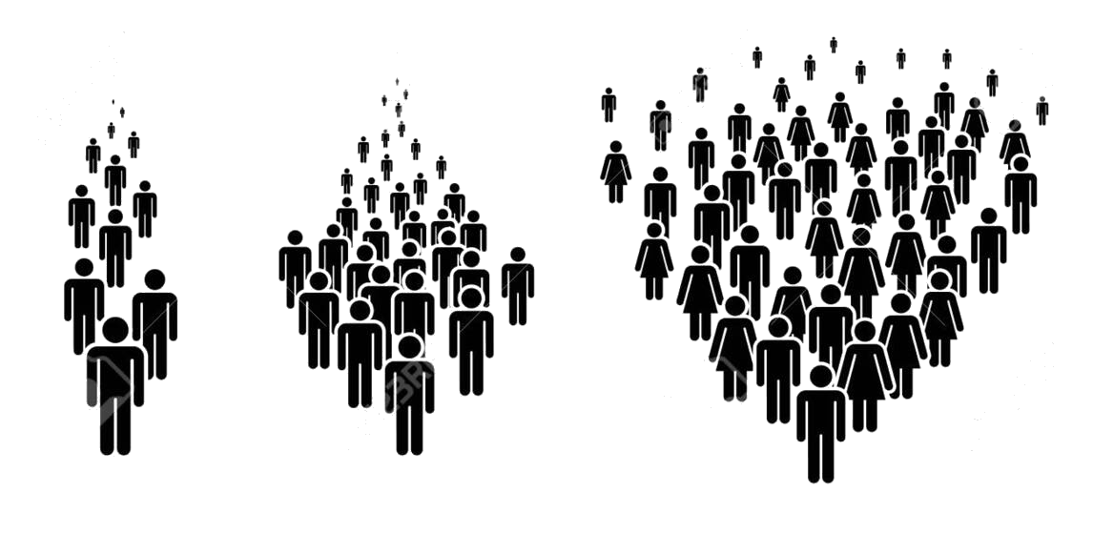
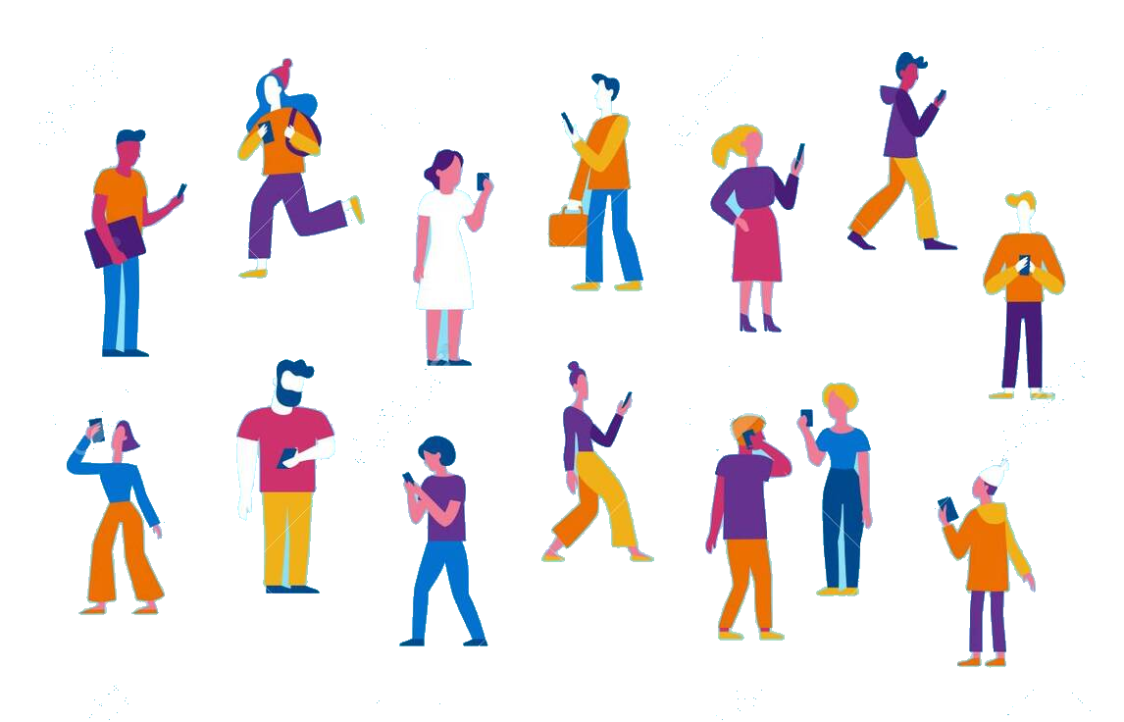
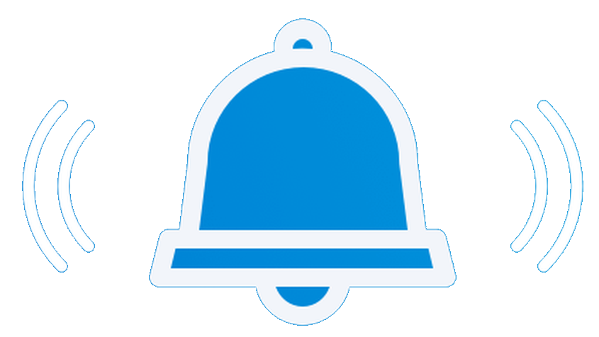
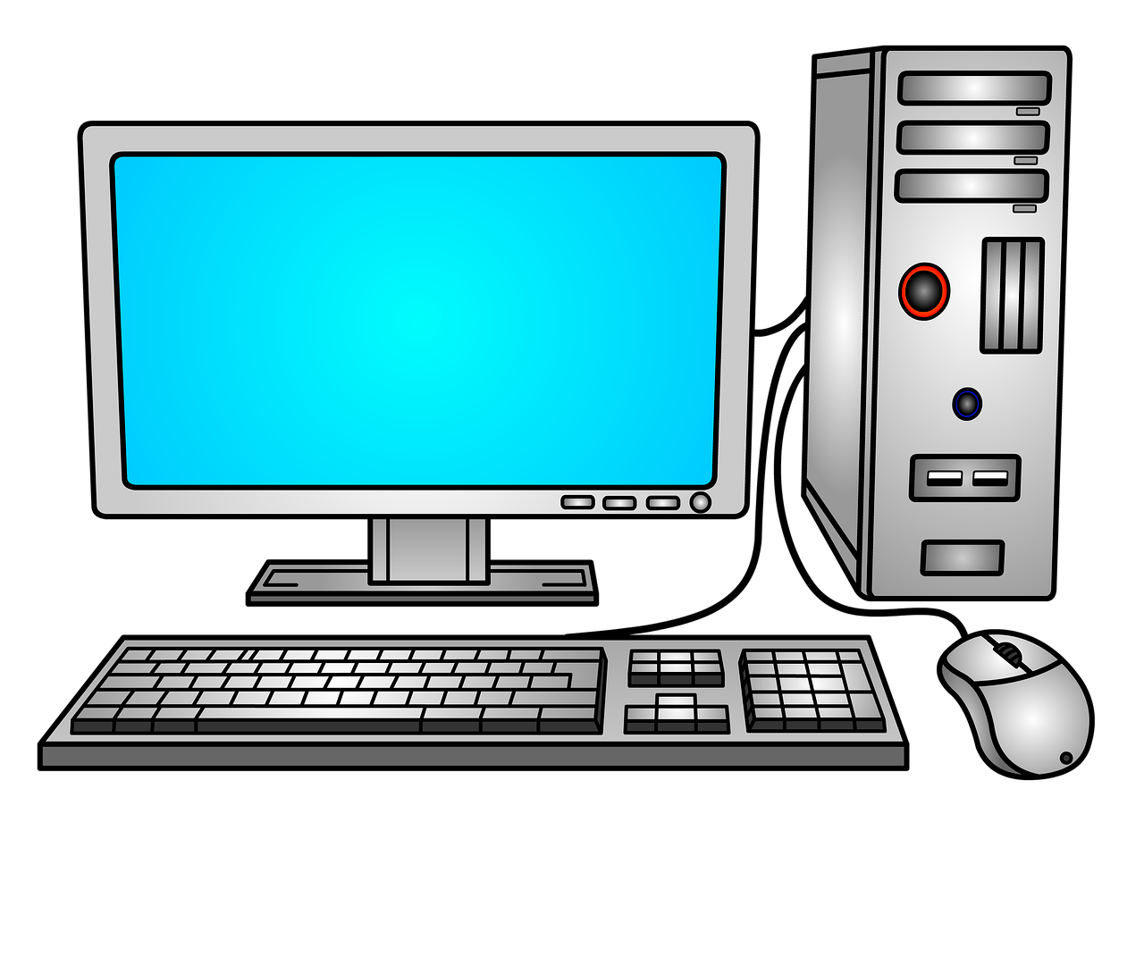
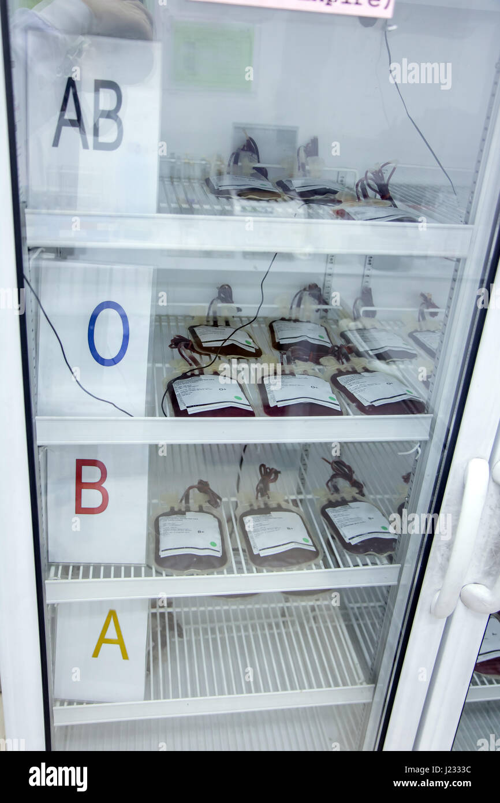

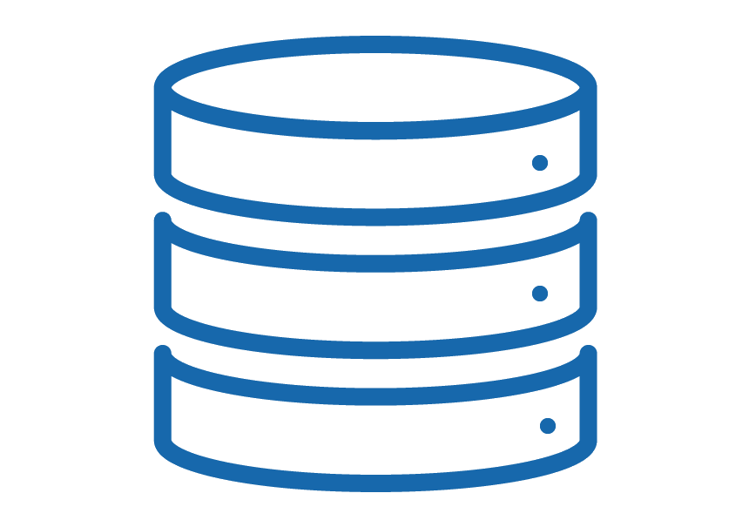
DC Concepts & Tools Usage %
Sending Notifications (Matches to receiver BG)
Users
Donor Registration
Server
Tools Used:
BACKEND – Spring framework
UI – HTML,CSS, BOOTSTRAP, JAVASCRIPT
DATABASE – MYSQL
TESTING – UNIT TESTING
METHOD - AGILE
Retrieving
User Location
Doctor posting receiver info
Storing
User Data
TOOLS USAGE %
BACKEND – 60%
UI – 25%
DATABASE – 10%
TESTING – 5%
Sending Notifications to Blood Bank (incase No donors Found)

Slide 5
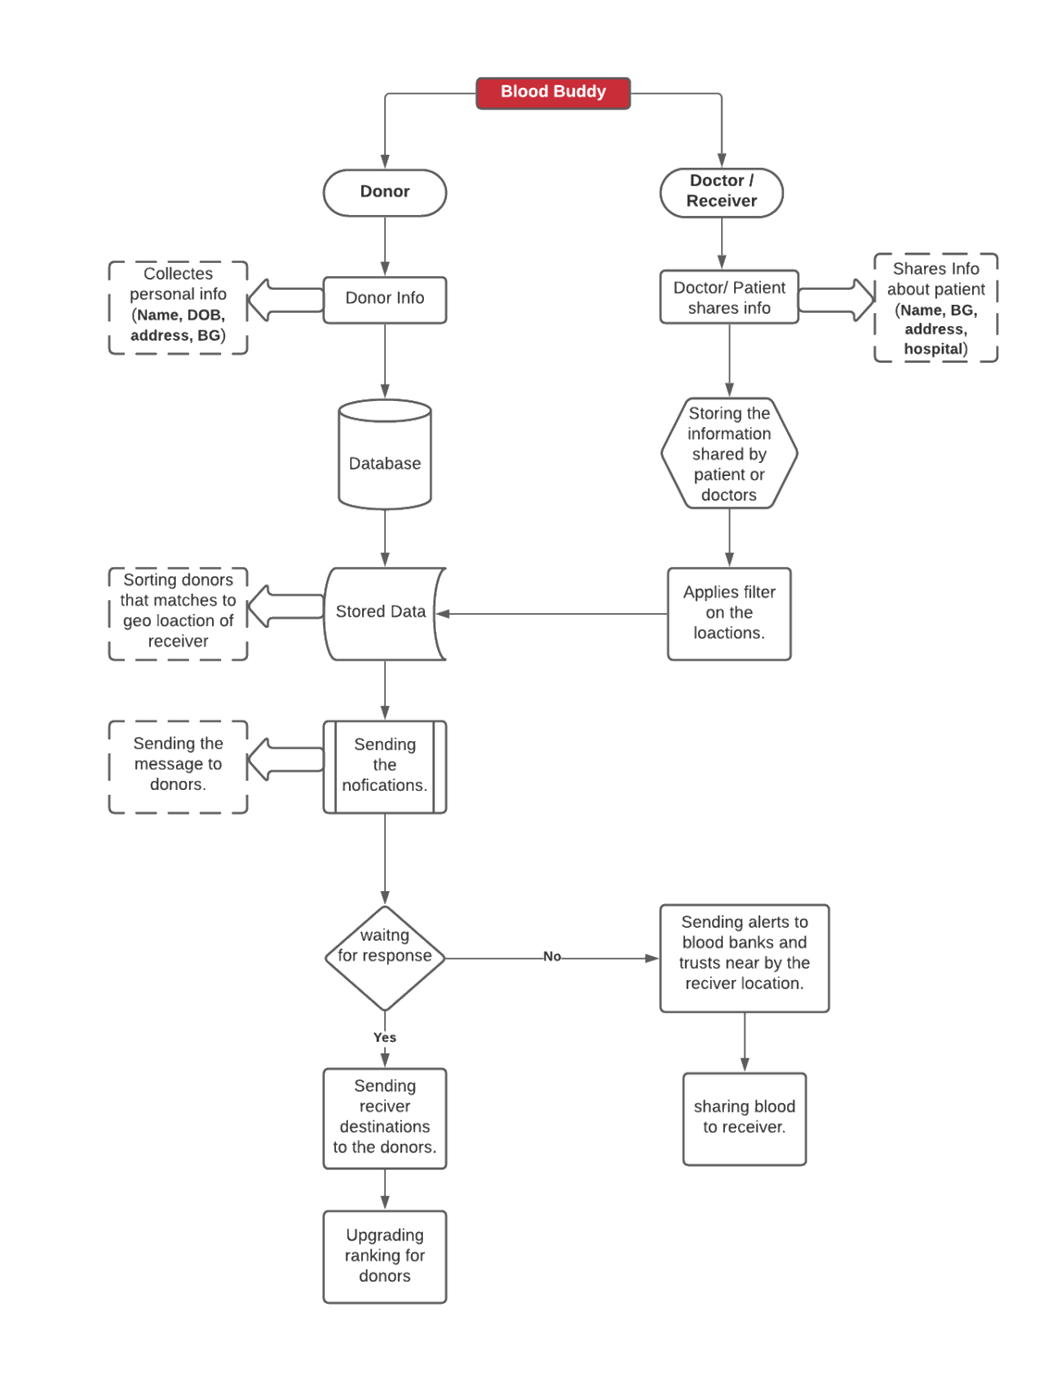
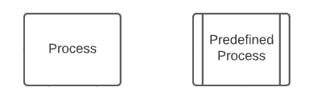
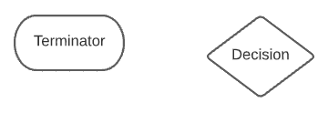
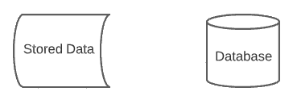
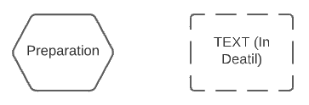
PROCESS OVERVIEW

Slide 6
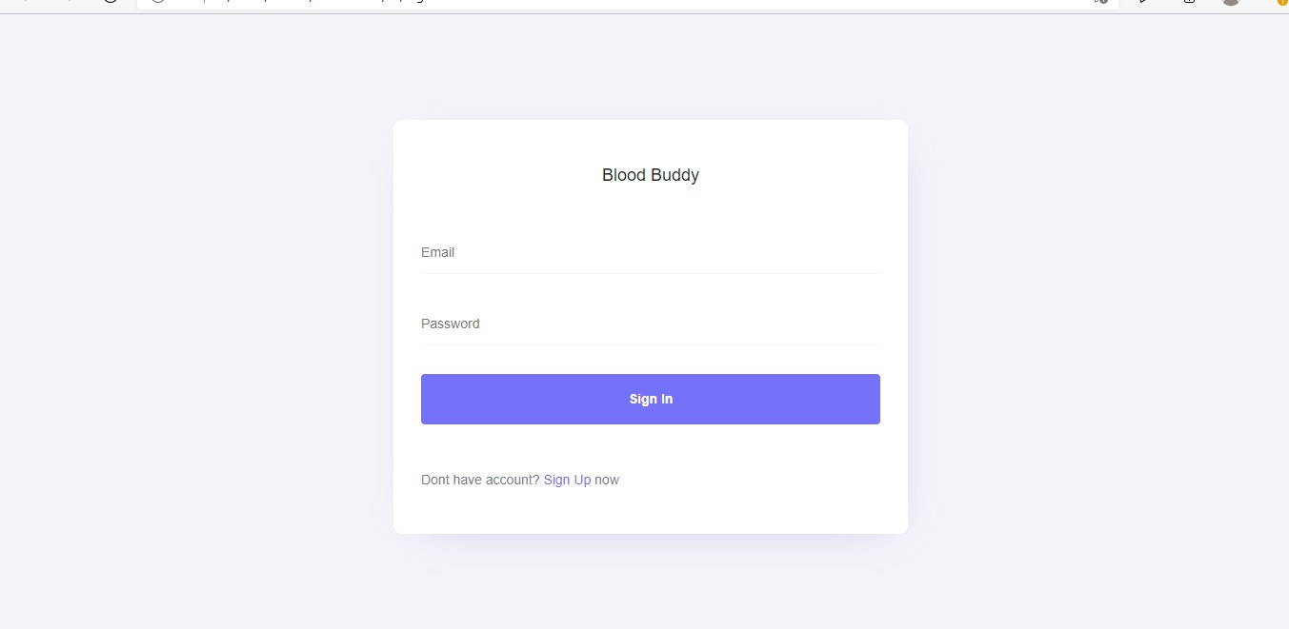
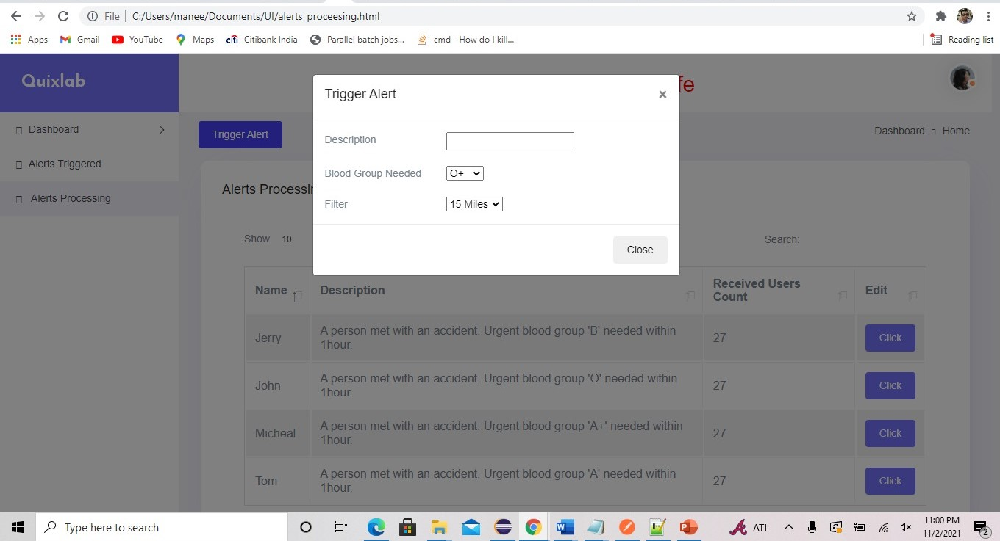
CURRENT PROGRESS & PLAN IMPLEMENTATION
Executions Stages:
Nov 4th – Design Presentation Submission.
Nov 6th – User Interface (UI) Completion.
Nov 9th – Database Design
Nov 20th – Backend completion
Nov 28th – Testing
Dec 5th – Final testing
Dec 11th – Submission
Current Progress:
Initiated with User Interface part.
Applications have 5 screens of total.
Completed 3 of them and the remaining are dependent on database.

Slide 7
Conclusion
We are using different concepts of Distributed Computing like availability, consistency, durability. Blood Buddy main motto is to share information to their appropriate destinations. Initiated with filtering the receiver geographic location and delivering the information to donors, that matches the receiver’s blood group in the form of notifications which increases the response rates.
Thank You
DC DYNAMITES

